Slide 1
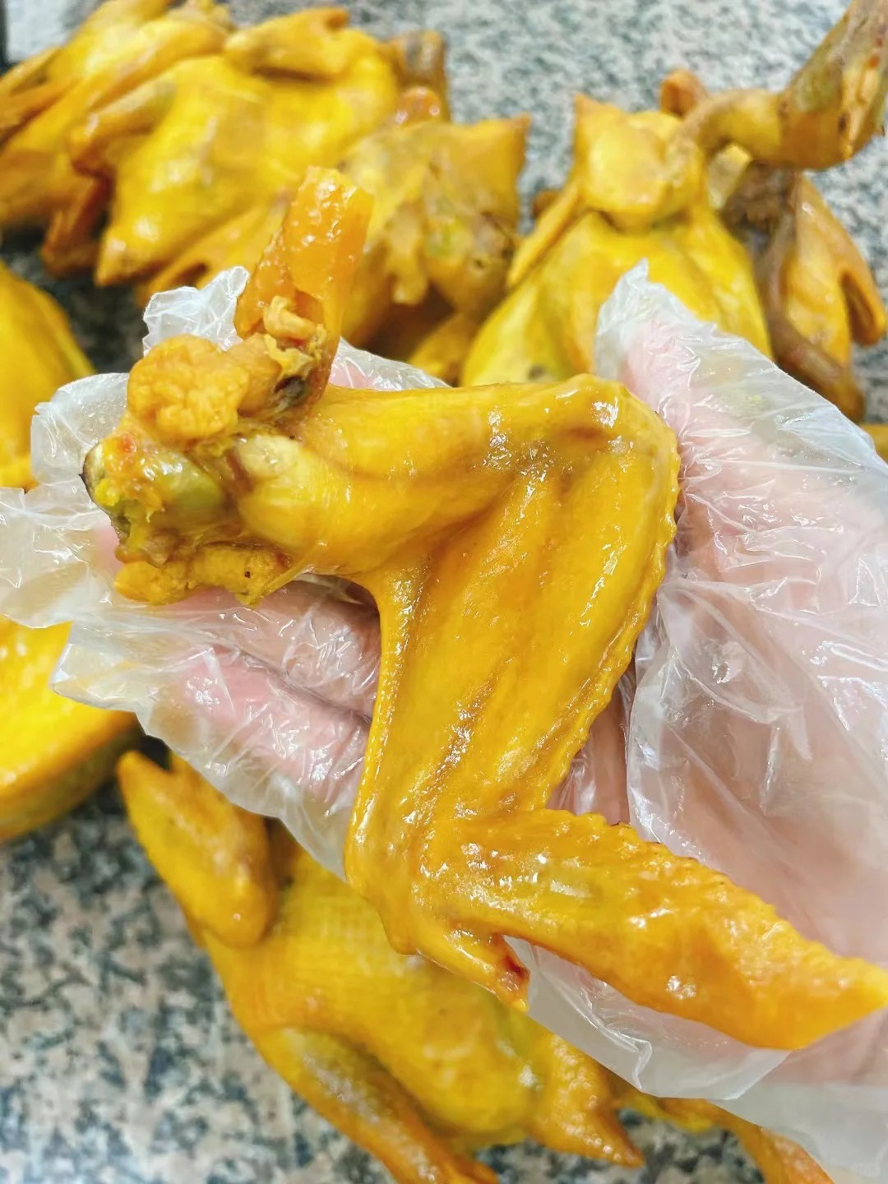
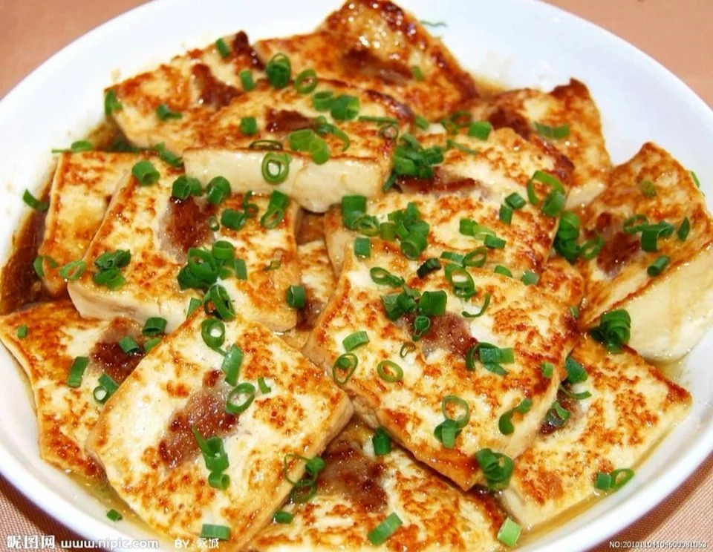
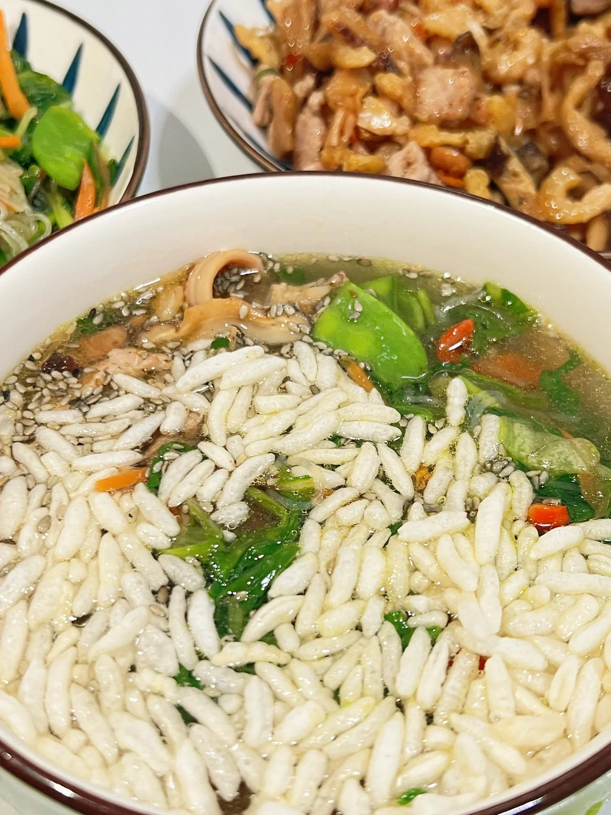
hometown foods
part3-heyuan guangdong&shanwei guangdong

Slide 2
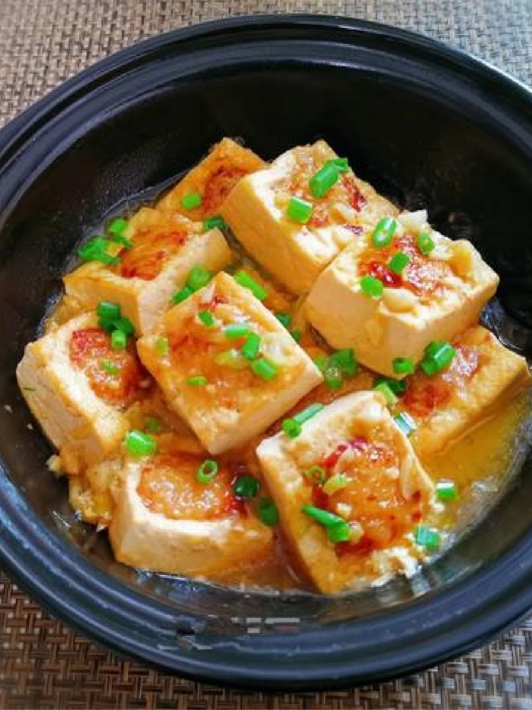
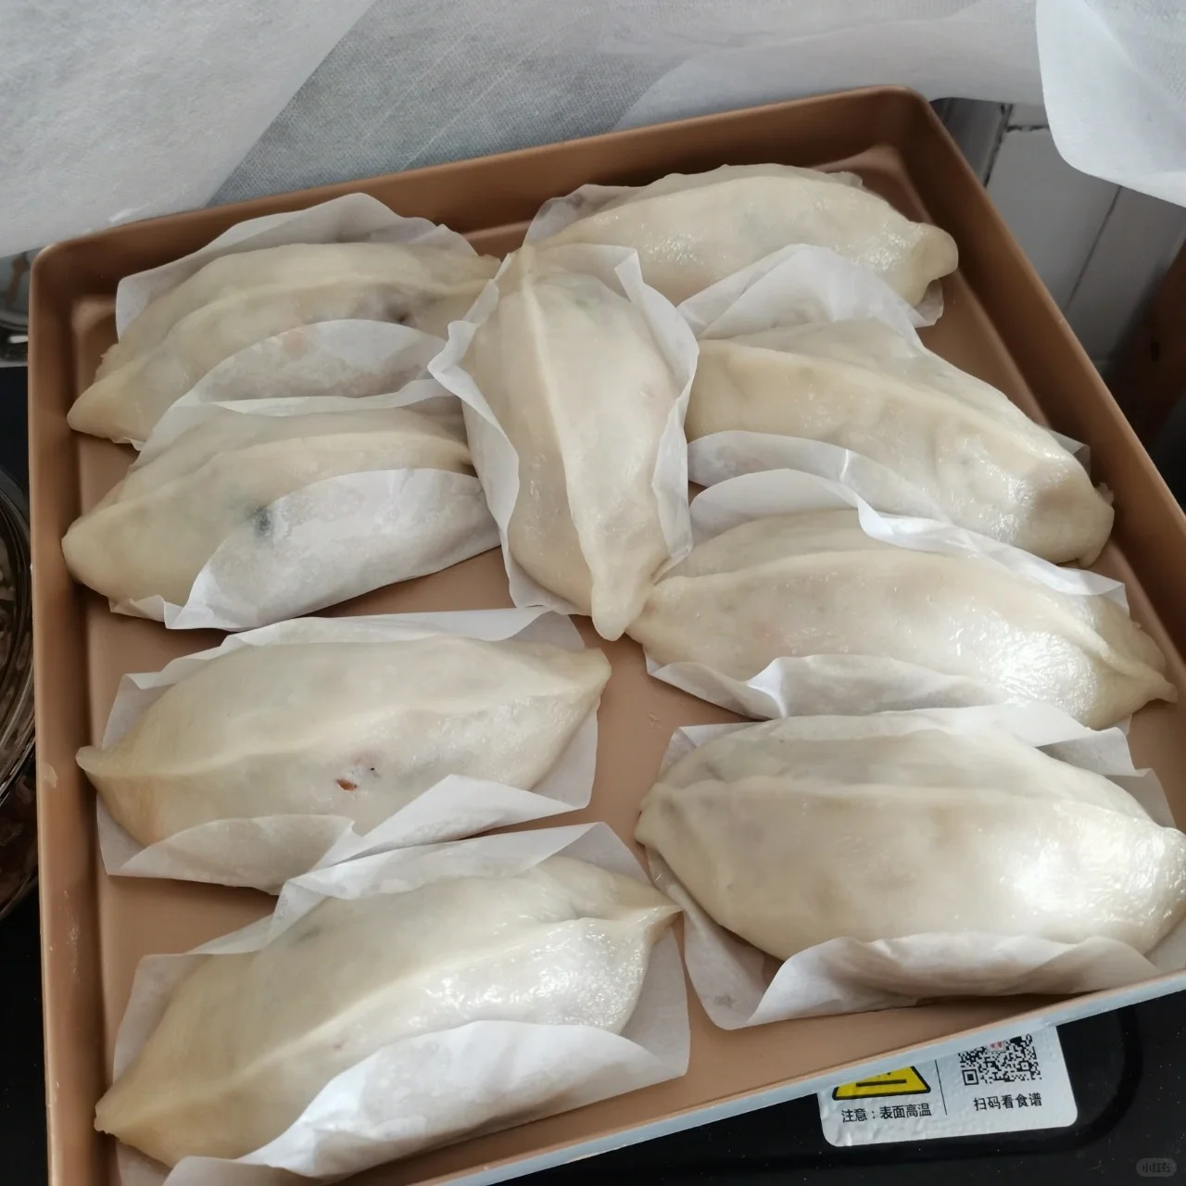
Heyuan delicious foods
luo po pan(萝卜粄)
Hakka Stuffed tofu
is delious which is an special Hakka foods
is made of radish，glutinous rice flour,some pork and small shrimp
is made of tofu,pork.

Slide 3
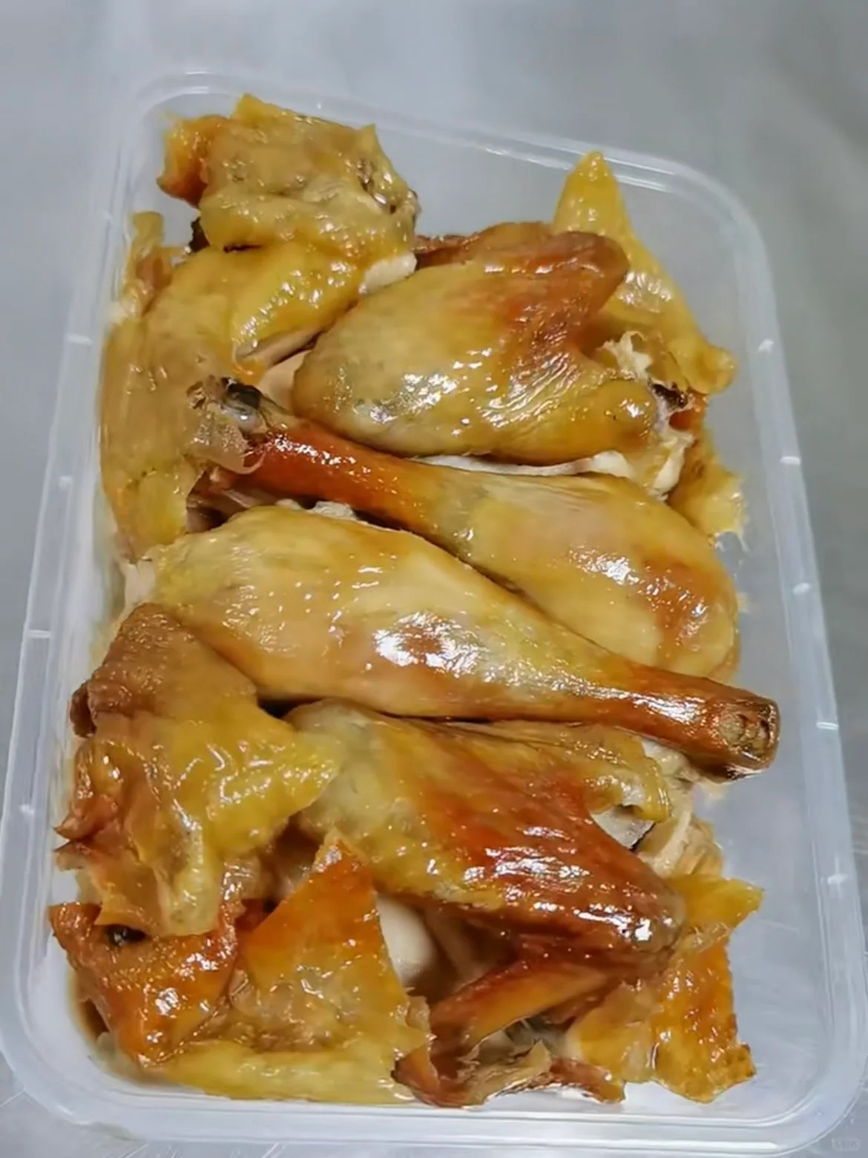
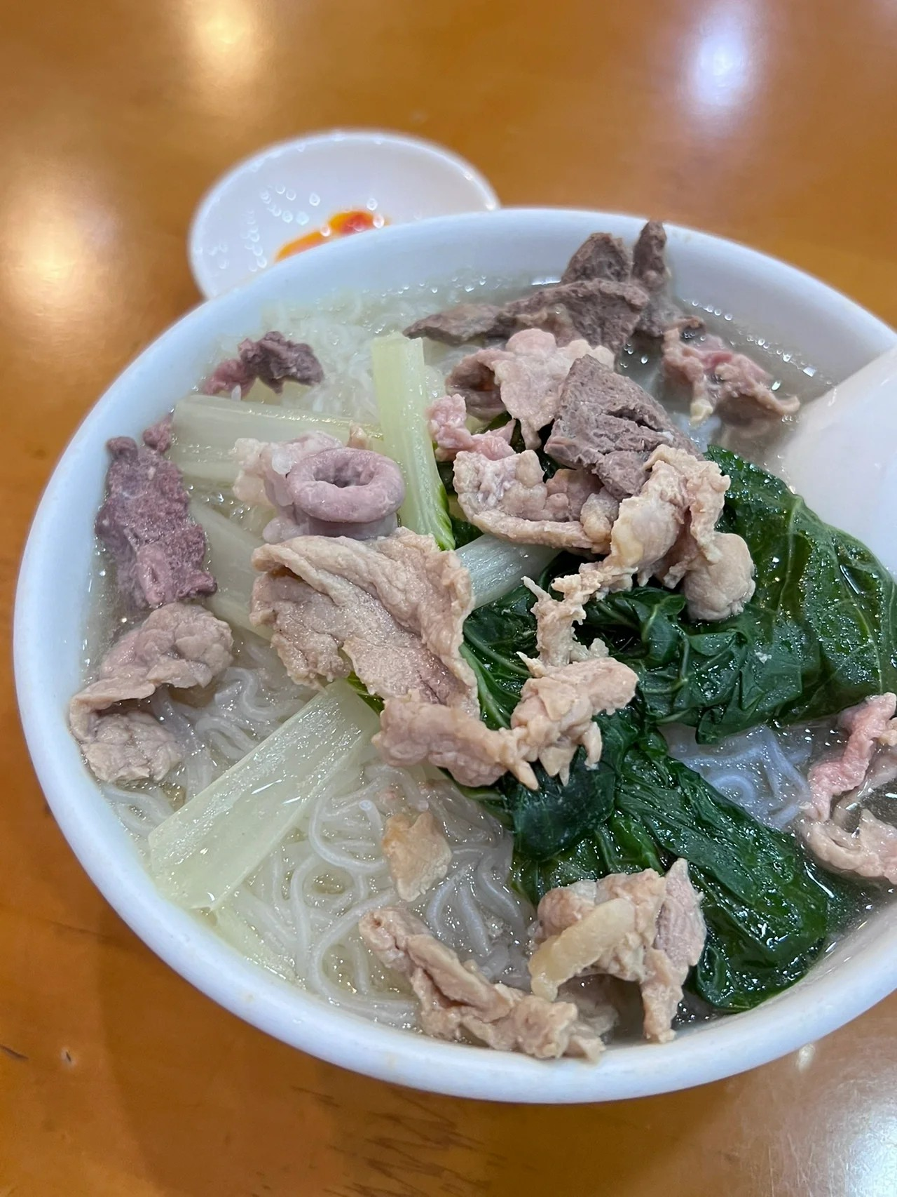
Heyuan delicious foods
wuzhi maotao chicken(五指毛桃鸡）
Hakka fans
is delious foos which is an special Hakka foods

Slide 4
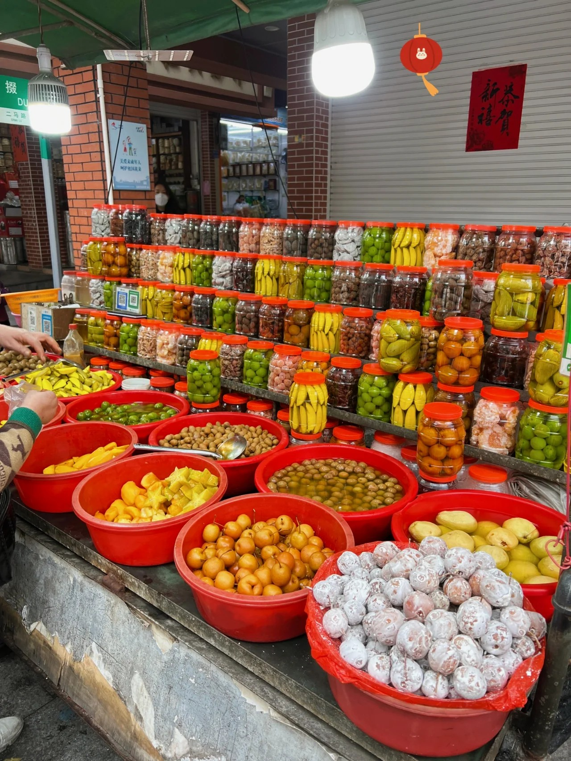
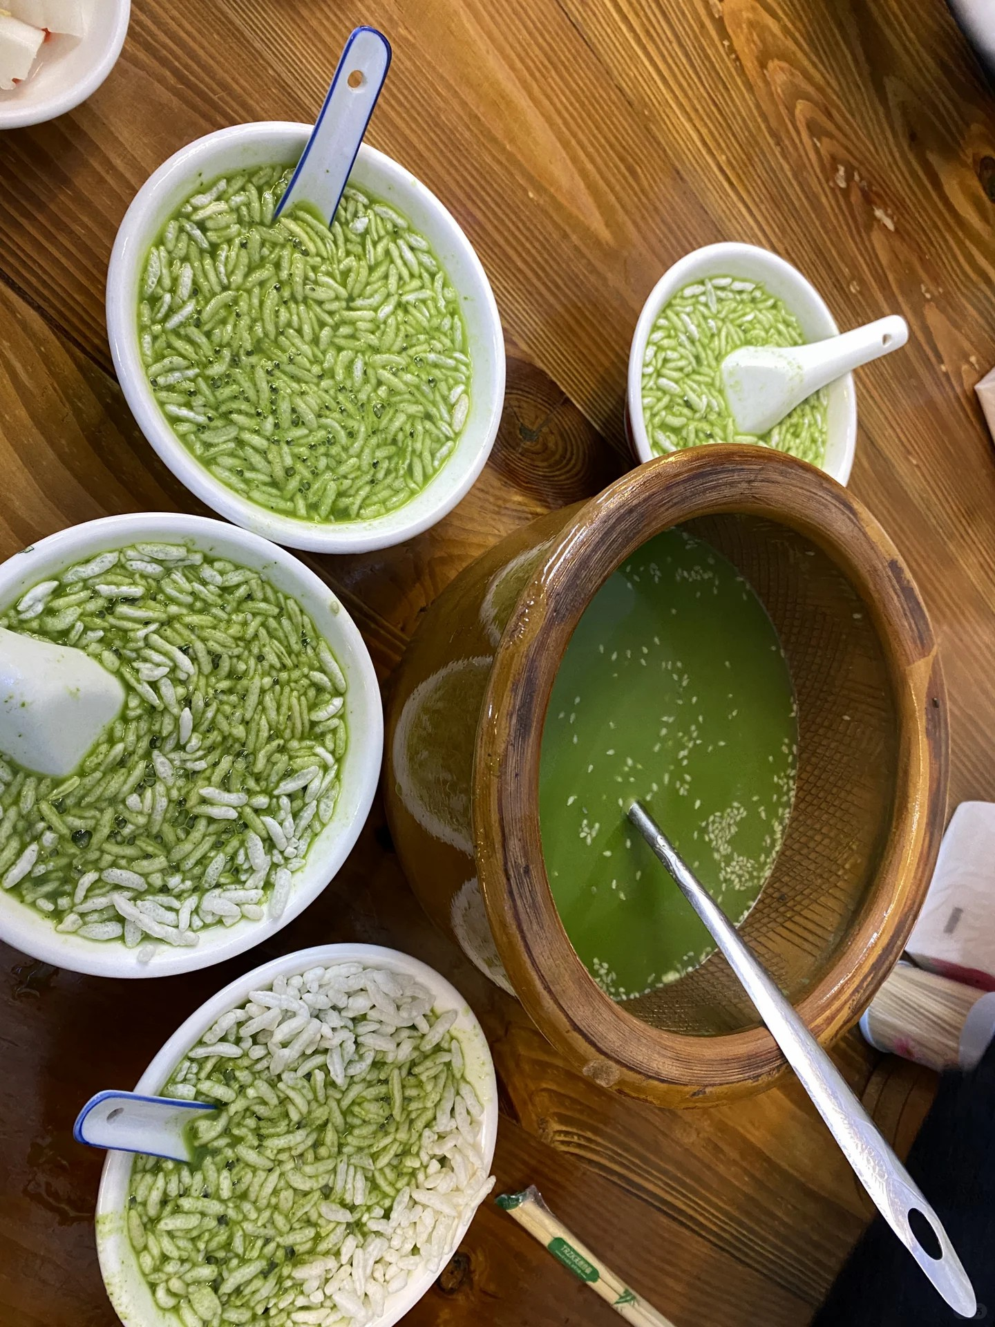
shanwei delicious foods
shanwei vegetable tea
furit cans
is delious foos which is an special
Chaoshan
foods

Slide 5
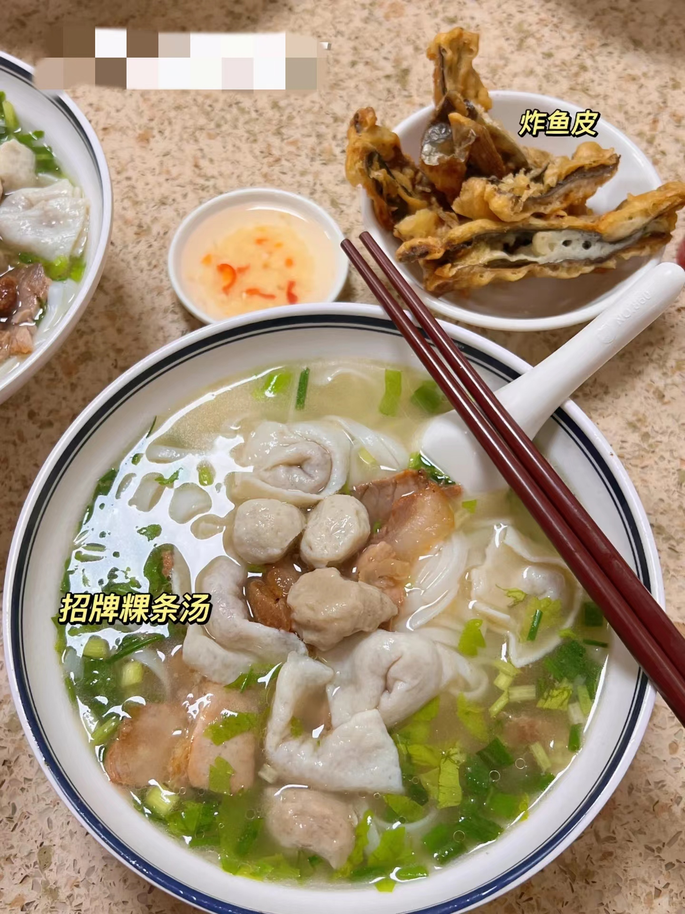
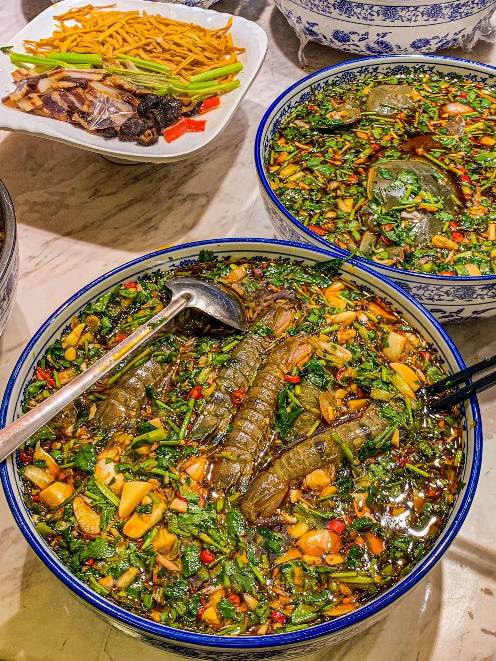
Heyuan delicious foods
Chaoshan Kway Teow
Chaoshan raw pickle
is delious foos which is an special Chaoshan foods

Slide 6
Thanks for you listen~
and the Kaffu Chino is the best of the world）

